Slide 1

KAMKAR
NETWORK PLAN
Mohamed - Sinan - Sami

Slide 2


CONTENT
01
OBJECTIVES
02
NETWORK DIAGRAM
03
SECURITY MEASURES
04
WHAT’S NEXT ?

Slide 3


OBJECTIVES
01
02
03
04
NETWORK
SECURITY
TEAM WORK
CISCO PACKET TRACER
MEASURES

Slide 4

01
02
03
04
NETWORK DIAGRAM

Slide 5
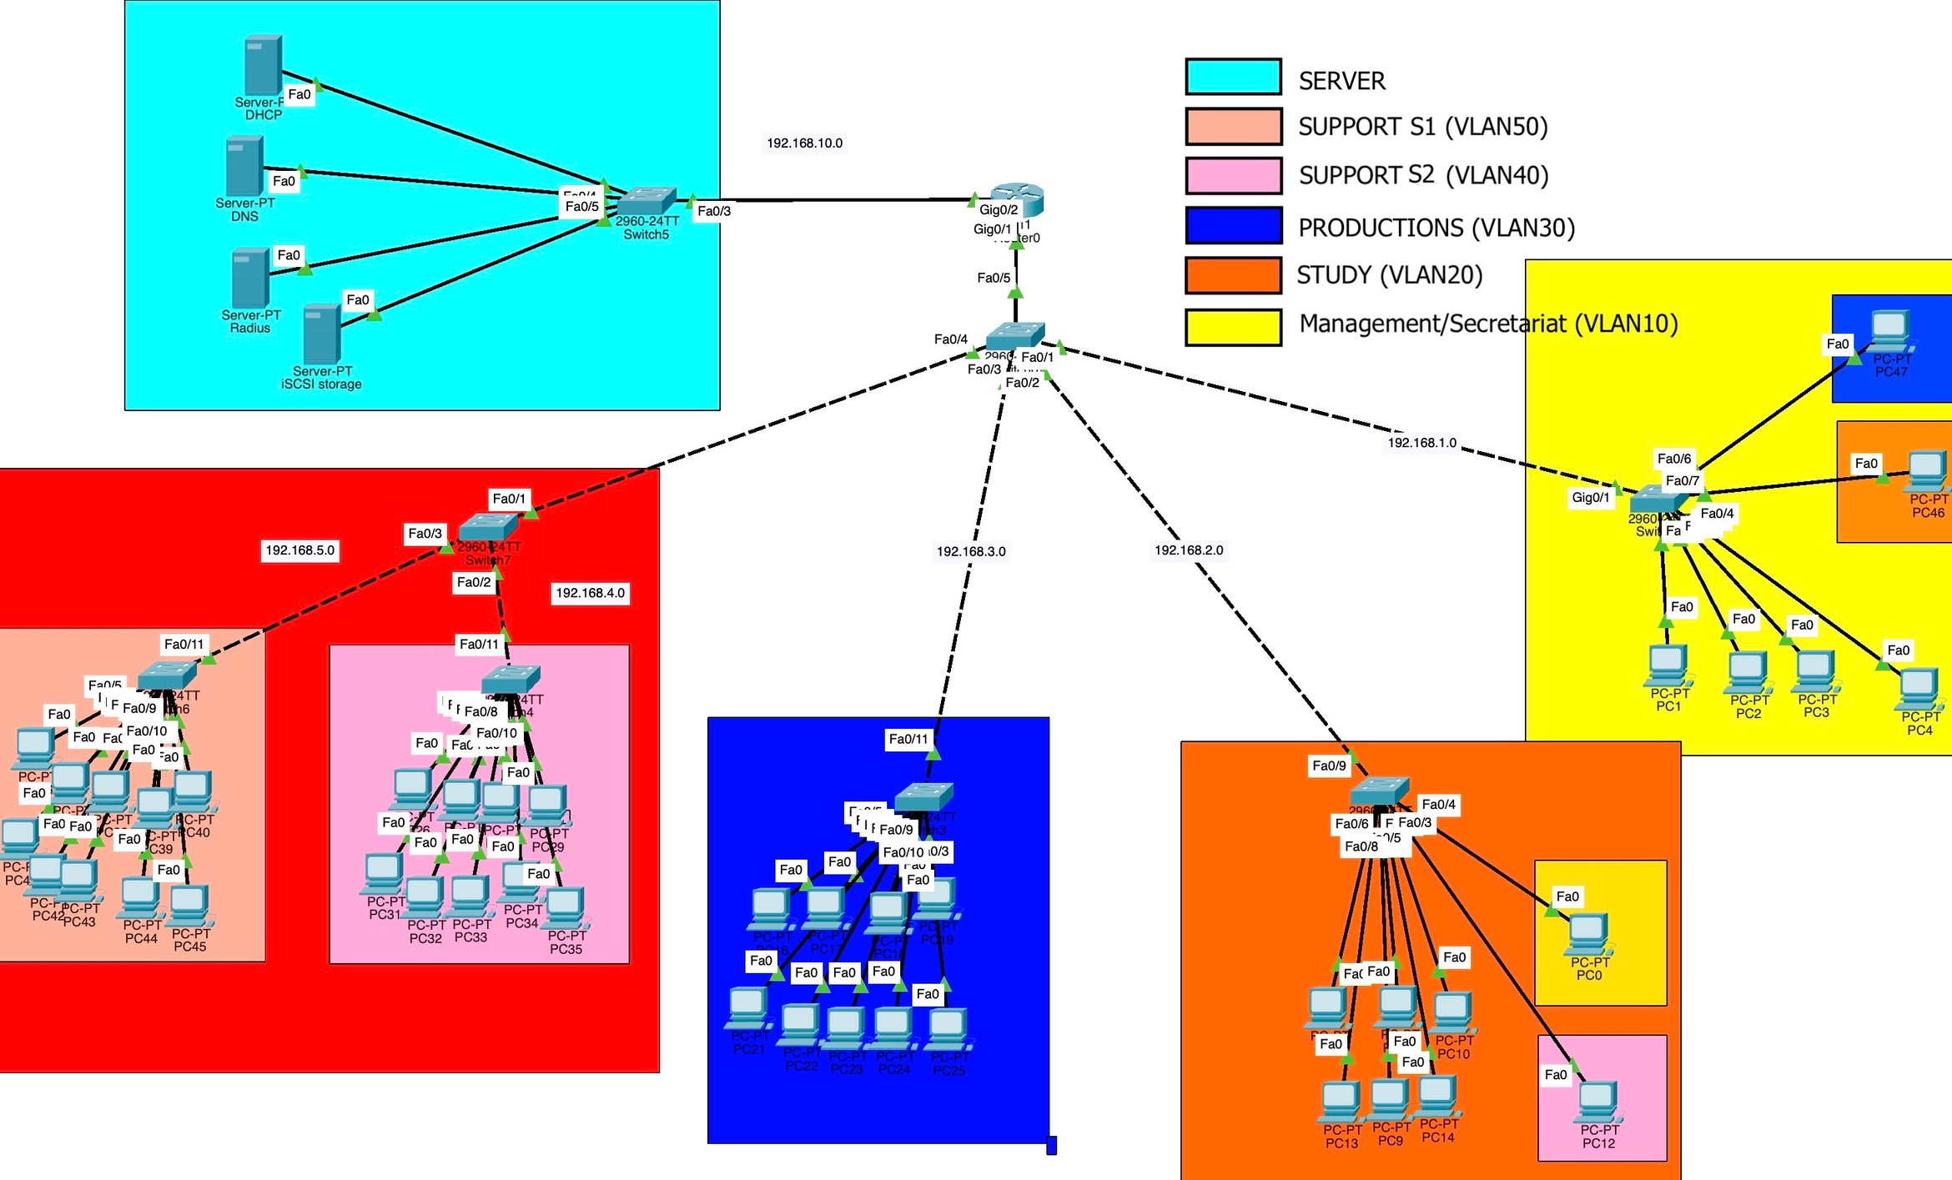

Slide 6

SECURITY MEASURES
03
Cross-Departmental Redundancy
Access list
Vlan (change default port)
Switches password management
Cable Management / Scalability
Radius Authentication

Slide 7
WHAT’S NEXT ?
FIREWALL
ACTIVE
DIRECTORY
RESSOURCES
OPTIMISATION
...

Slide 8

01
02
04
THANK YOU

